Slide 1
* Science 8
Chapter 2-Lesson 4—Momentum = Mass∙Velocity Notes

Slide 2
Math Skills
Momentum Equation

Slide 3
Date

Slide 4
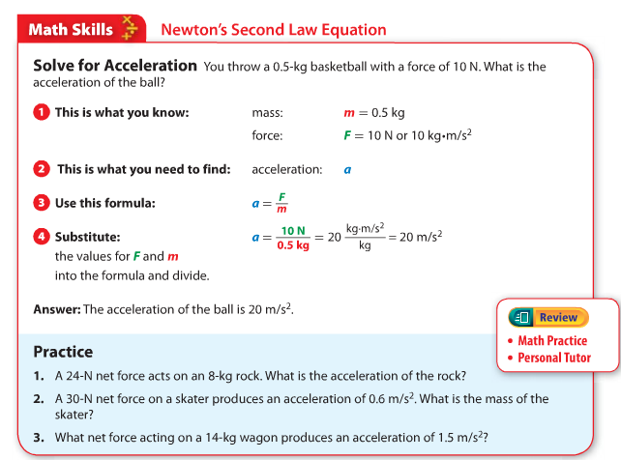
Open your books to page 73!

Slide 5
Notes
p = momentum (kg ● m/s)
m = mass (kg)
v = velocity (m/s)
p = m ● v

Slide 6
Example
Solve for Momentum
What is the momentum of a 12-kg bicycle moving at 5.5 m/s?

Slide 7
This is what you know.
mass
m = 12 kg
velocityforc
v = 5.5 m/s

Slide 8
This is what you need to find:
momentum: p

Slide 9

Use this formula:
p $=m \text{×} \text{v}$

Slide 10
Substitute:
the values for v and m into the formula and multiply.
p $=12 kg ×5.5 m/s$
p $=66 kg ∙ m/s$

Slide 11
Answer:
The momentum of the bicycle is $66 kg ● m/s$ in the direction of the velocity.

Slide 12
Practice

Slide 13
Problem #1
What is the momentum of a 1.5-kg ball rolling at 3.0 m/s ?
What do we know?
velocity = 3.0 m/s
mass = 1.5 kg
What do we need to find?
momentum

Slide 14
Problem #1
What is the formula?
$p=m ∙v$
Substitute in known values.
$p=1.5 kg ∙3.0 m/s$
$p=4.5 kg ∙m/s$

Slide 15
Problem #2
A 55-kg woman has a momentum of 220 kg ∙ m/s. What is her velocity?
What do we know?
Momentum = 220 kg ∙ m/s
Mass = 55 kg
What do we need to find?
Velocity
Can we put the numbers in the same place as the last time?

Slide 16
Problem #2
What is the formula?
$p=m ∙v$
Substitute in known values.
$220 kg ∙\text{m}\text{/}\text{s}$ = 55 kg ∙ v
$\frac{220 kg ∙m/s }{55 kg}$ = v
v = 4 m/s

Slide 17
Review
Momentum is a measure of how hard it is to stop a moving object, and it is the product of an object’s mass and velocity. This can be shown by the equation below, where p = momentum (in kg·m/s), m = mass (in kg), and v = velocity (in m/s).
Equation p = m × v
You can rearrange the equation to solve for velocity or mass.
$m= \frac{p}{v}$
v $= \frac{p}{m}$

Slide 18
Example
If a 4.5-kg bowling ball is rolled down the bowling lane with a velocity of 6 m/s, what is the momentum of the ball?
Step 1 Identify the variable you will solve for and choose the appropriate equation.
You are solving for p, the momentum.
p = m × v
Step 2 Substitute the known values to solve the equation.
p = 4.5 kg × 6 m/s
p = 27 kg·m/s

Slide 19
The End!

